Slide 1
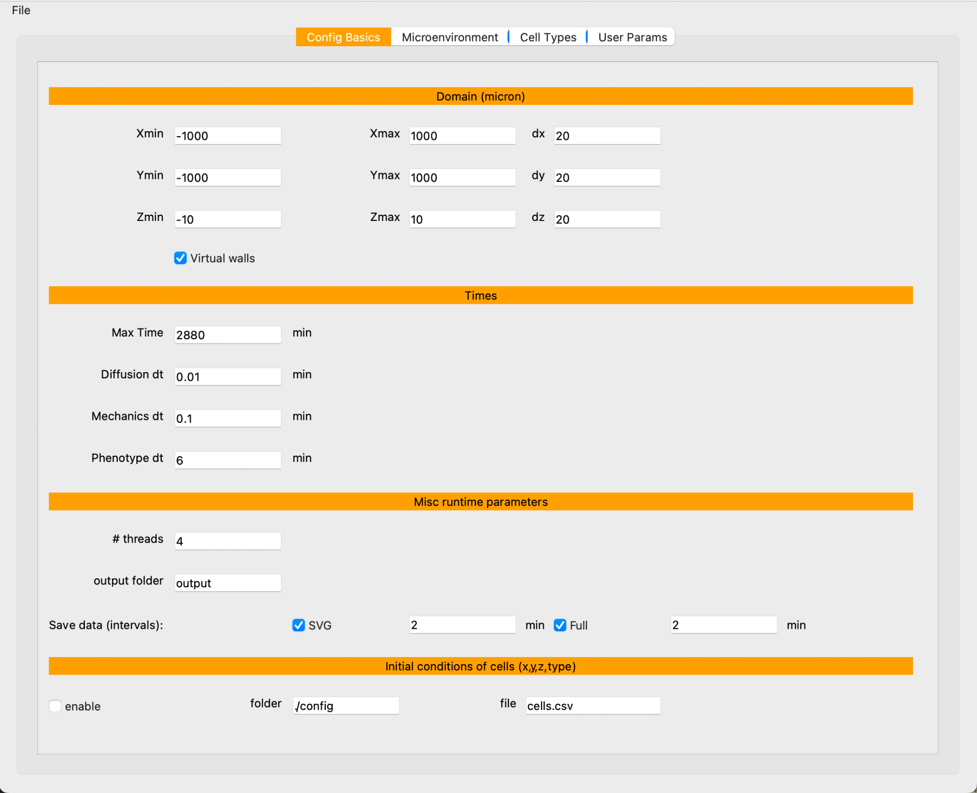
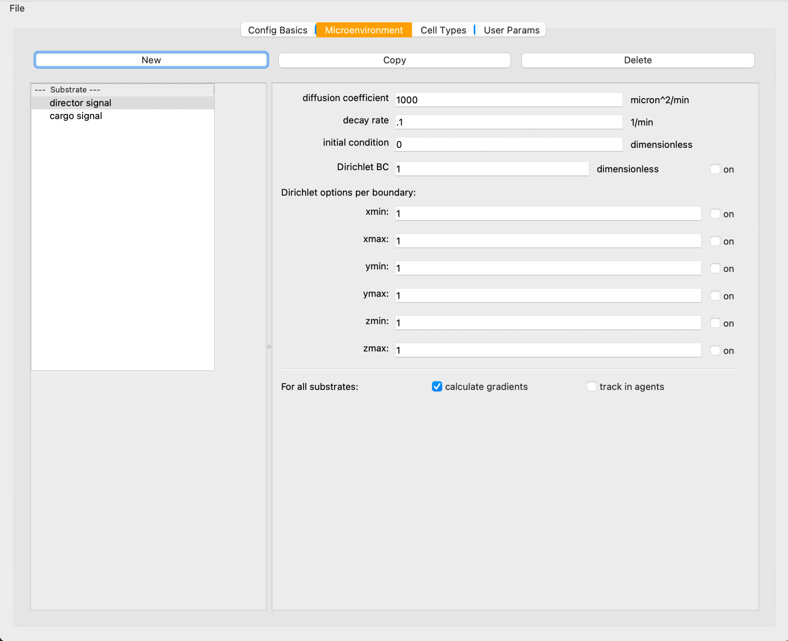
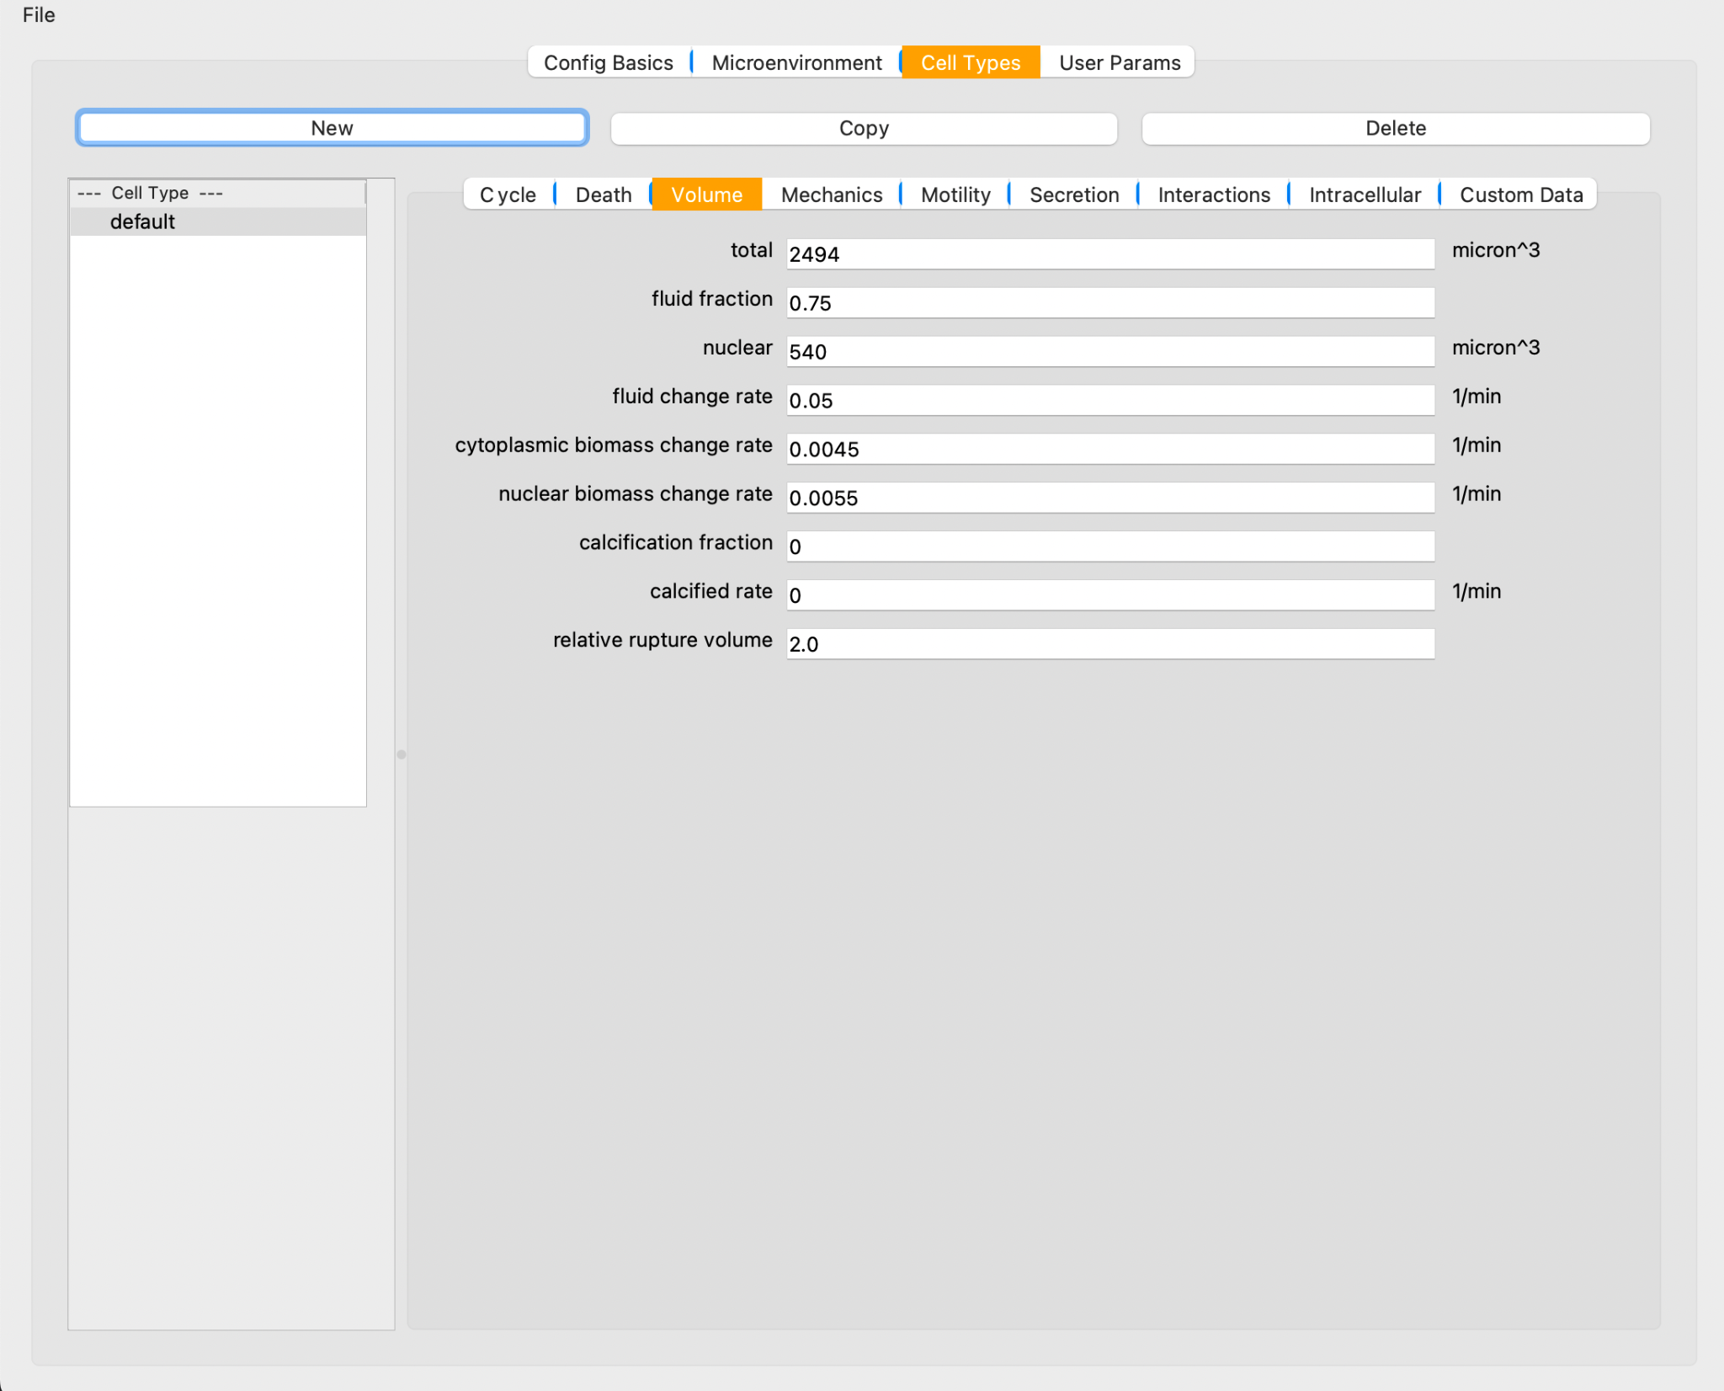
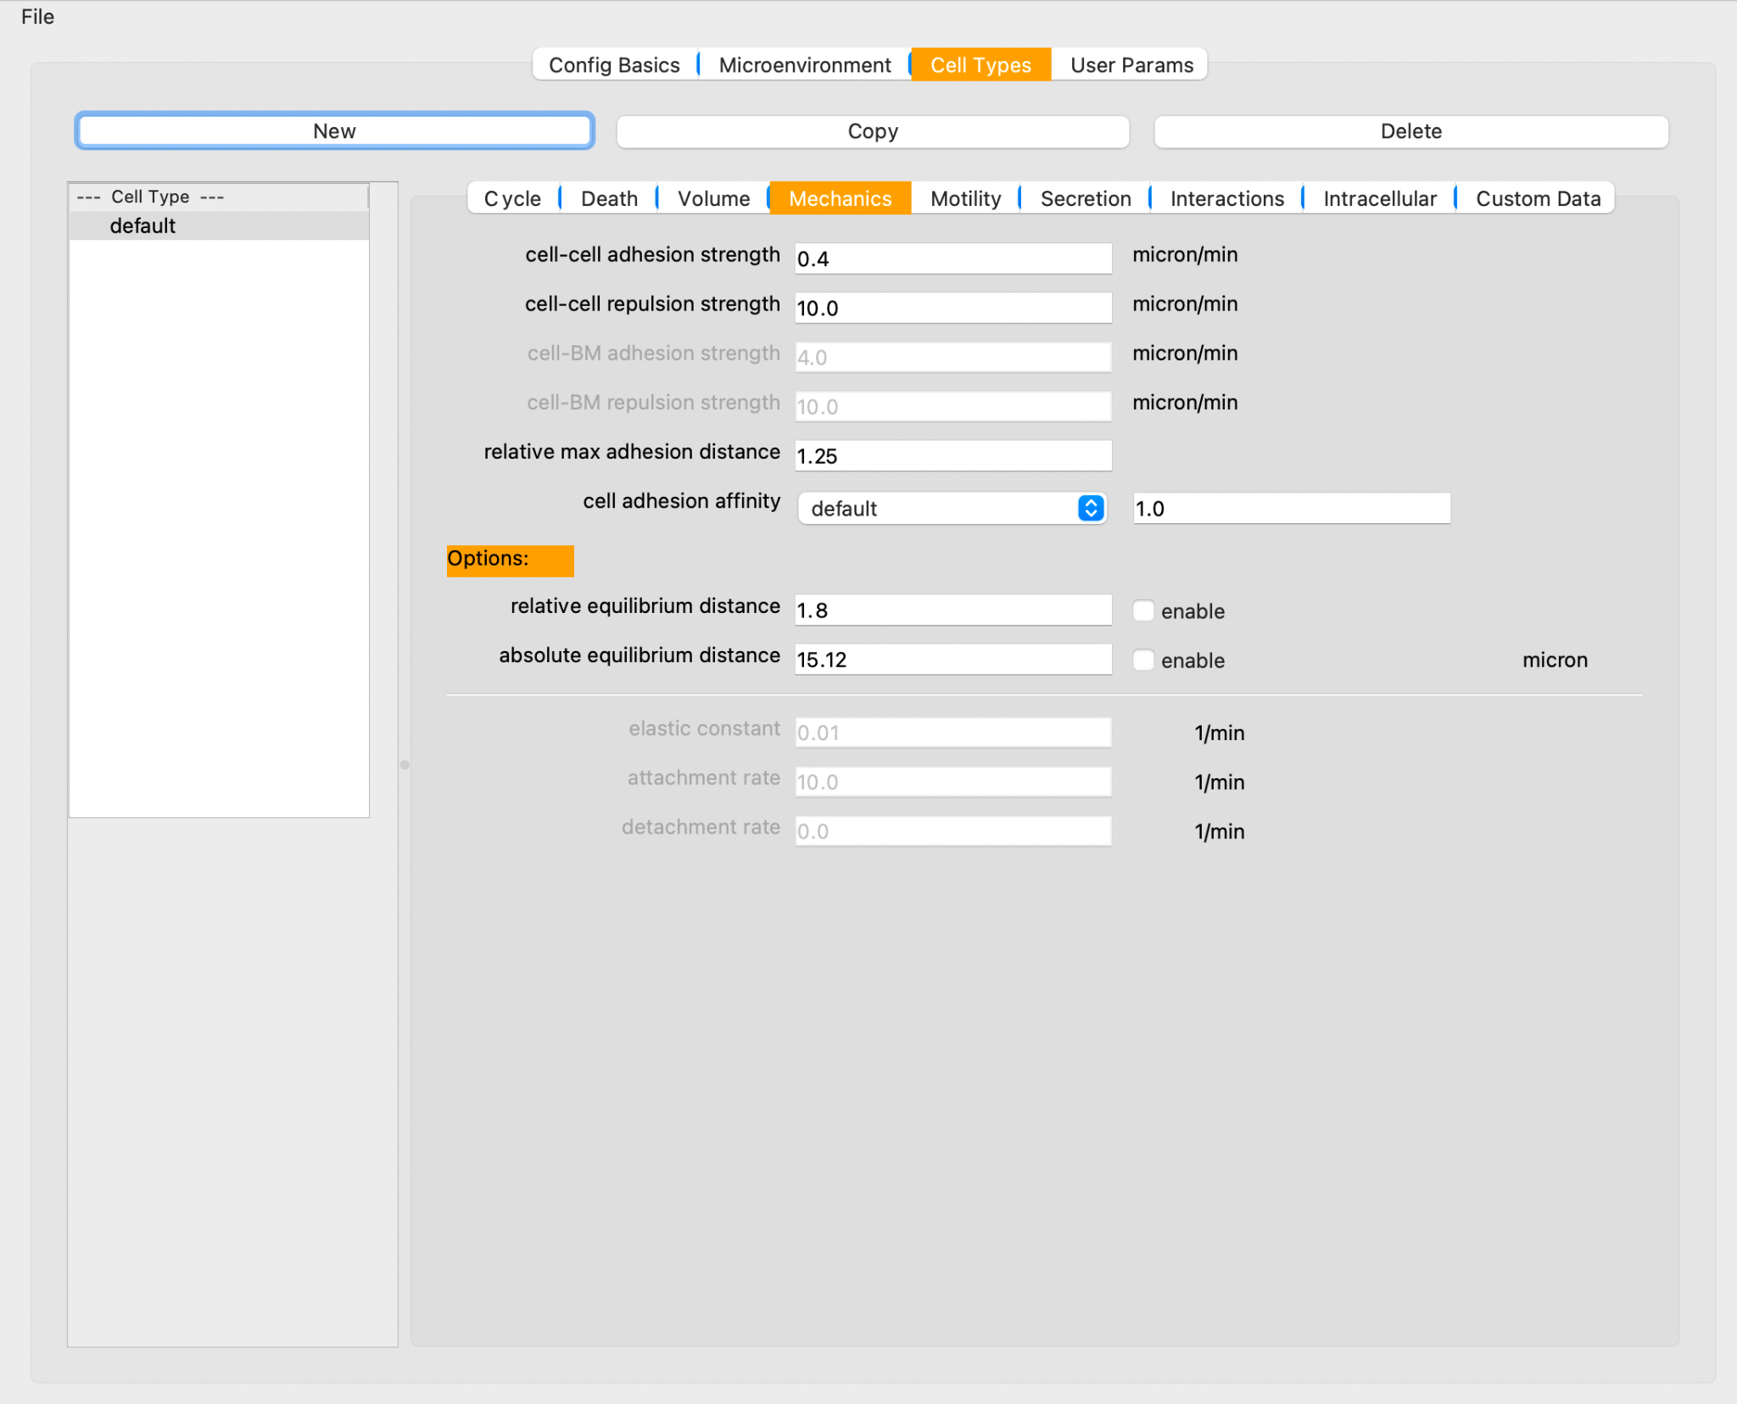
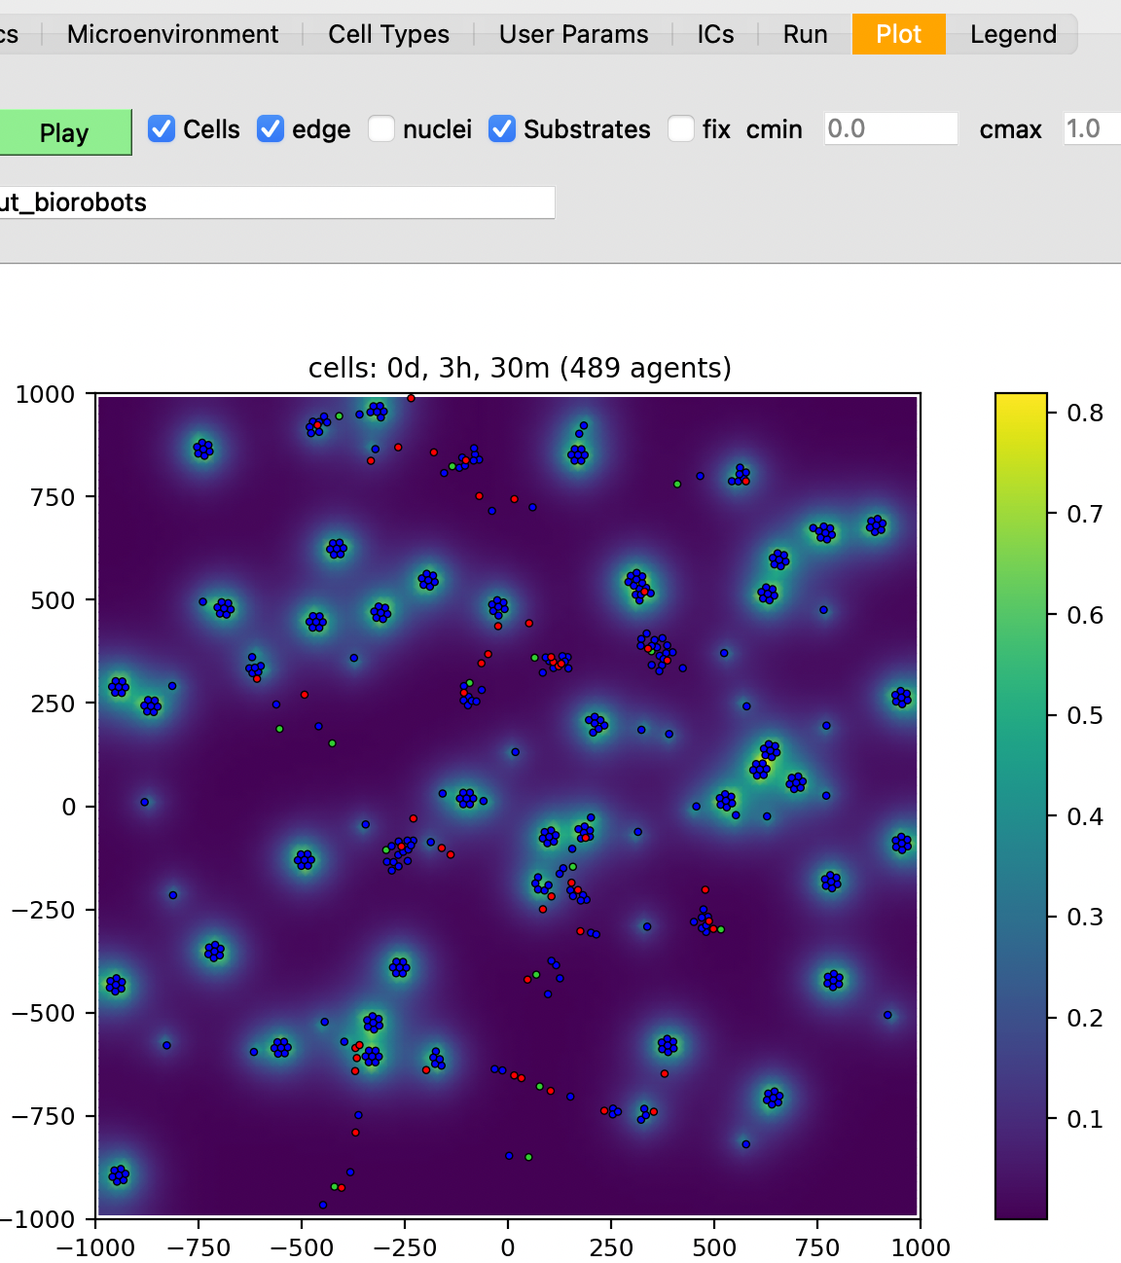
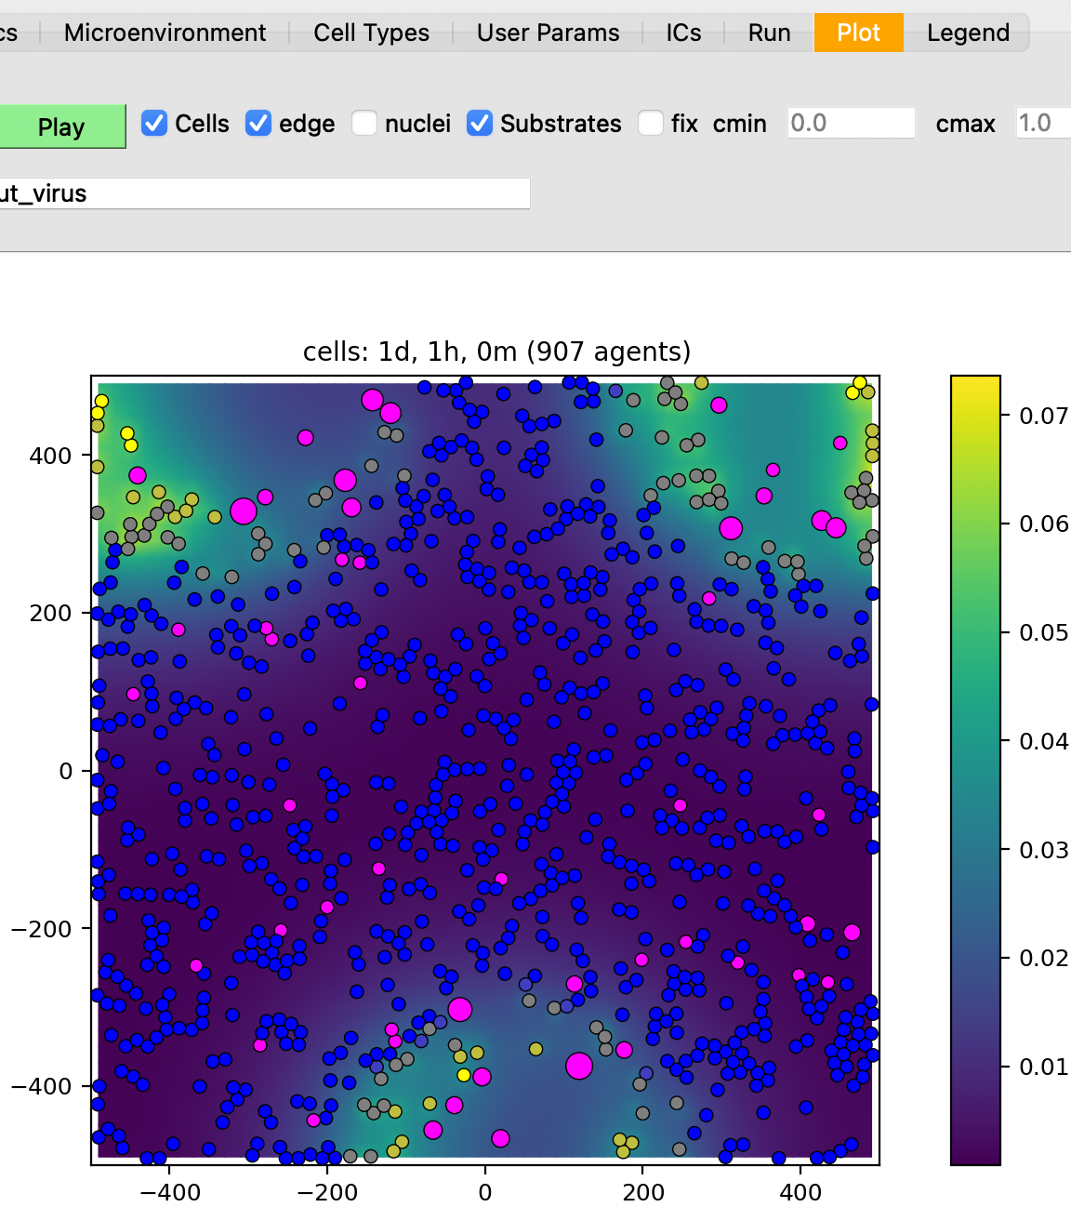
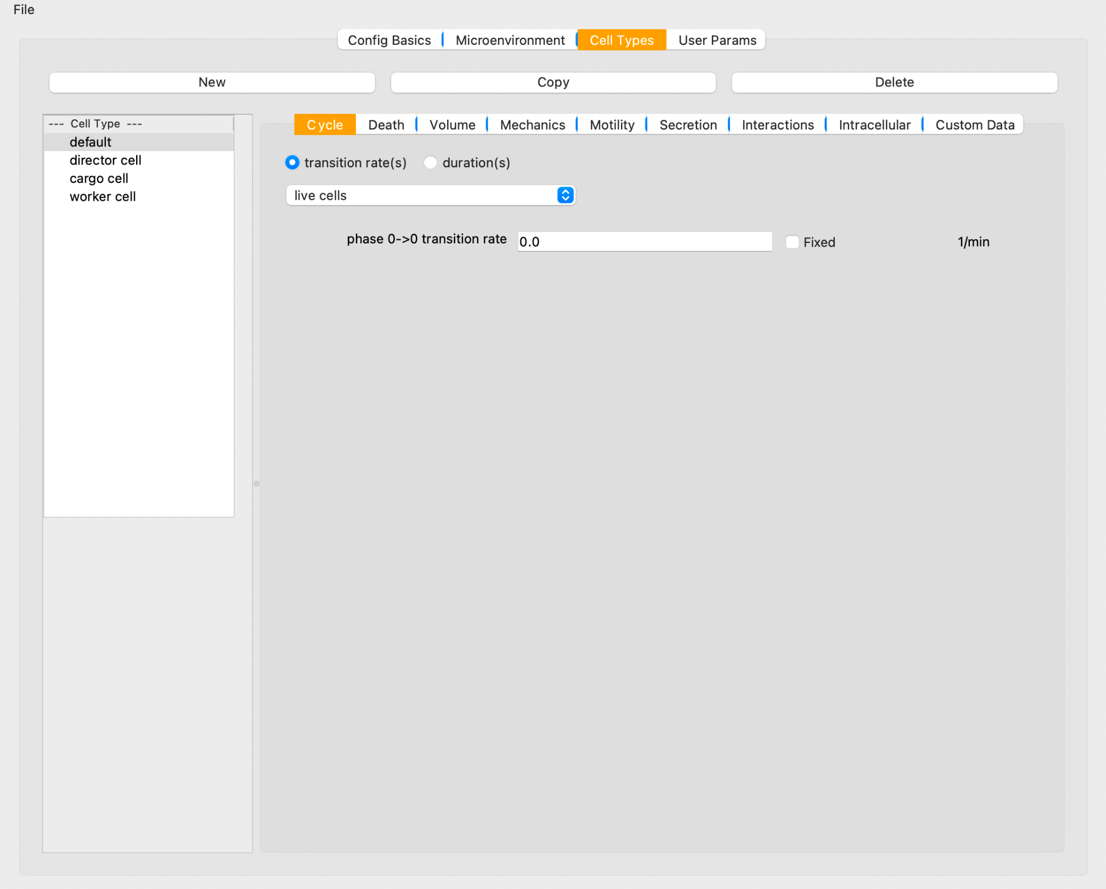
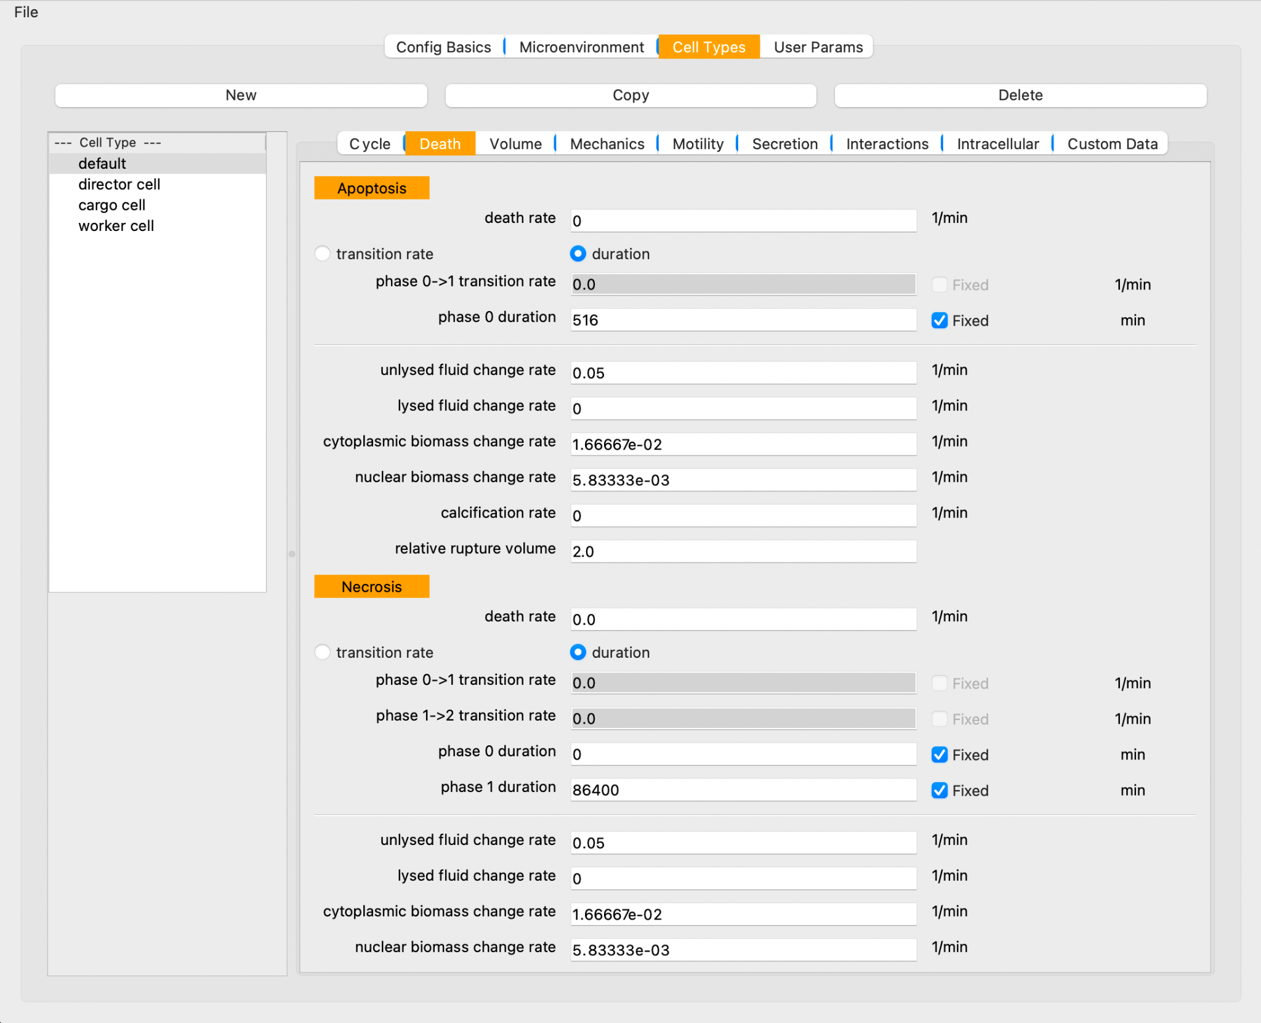
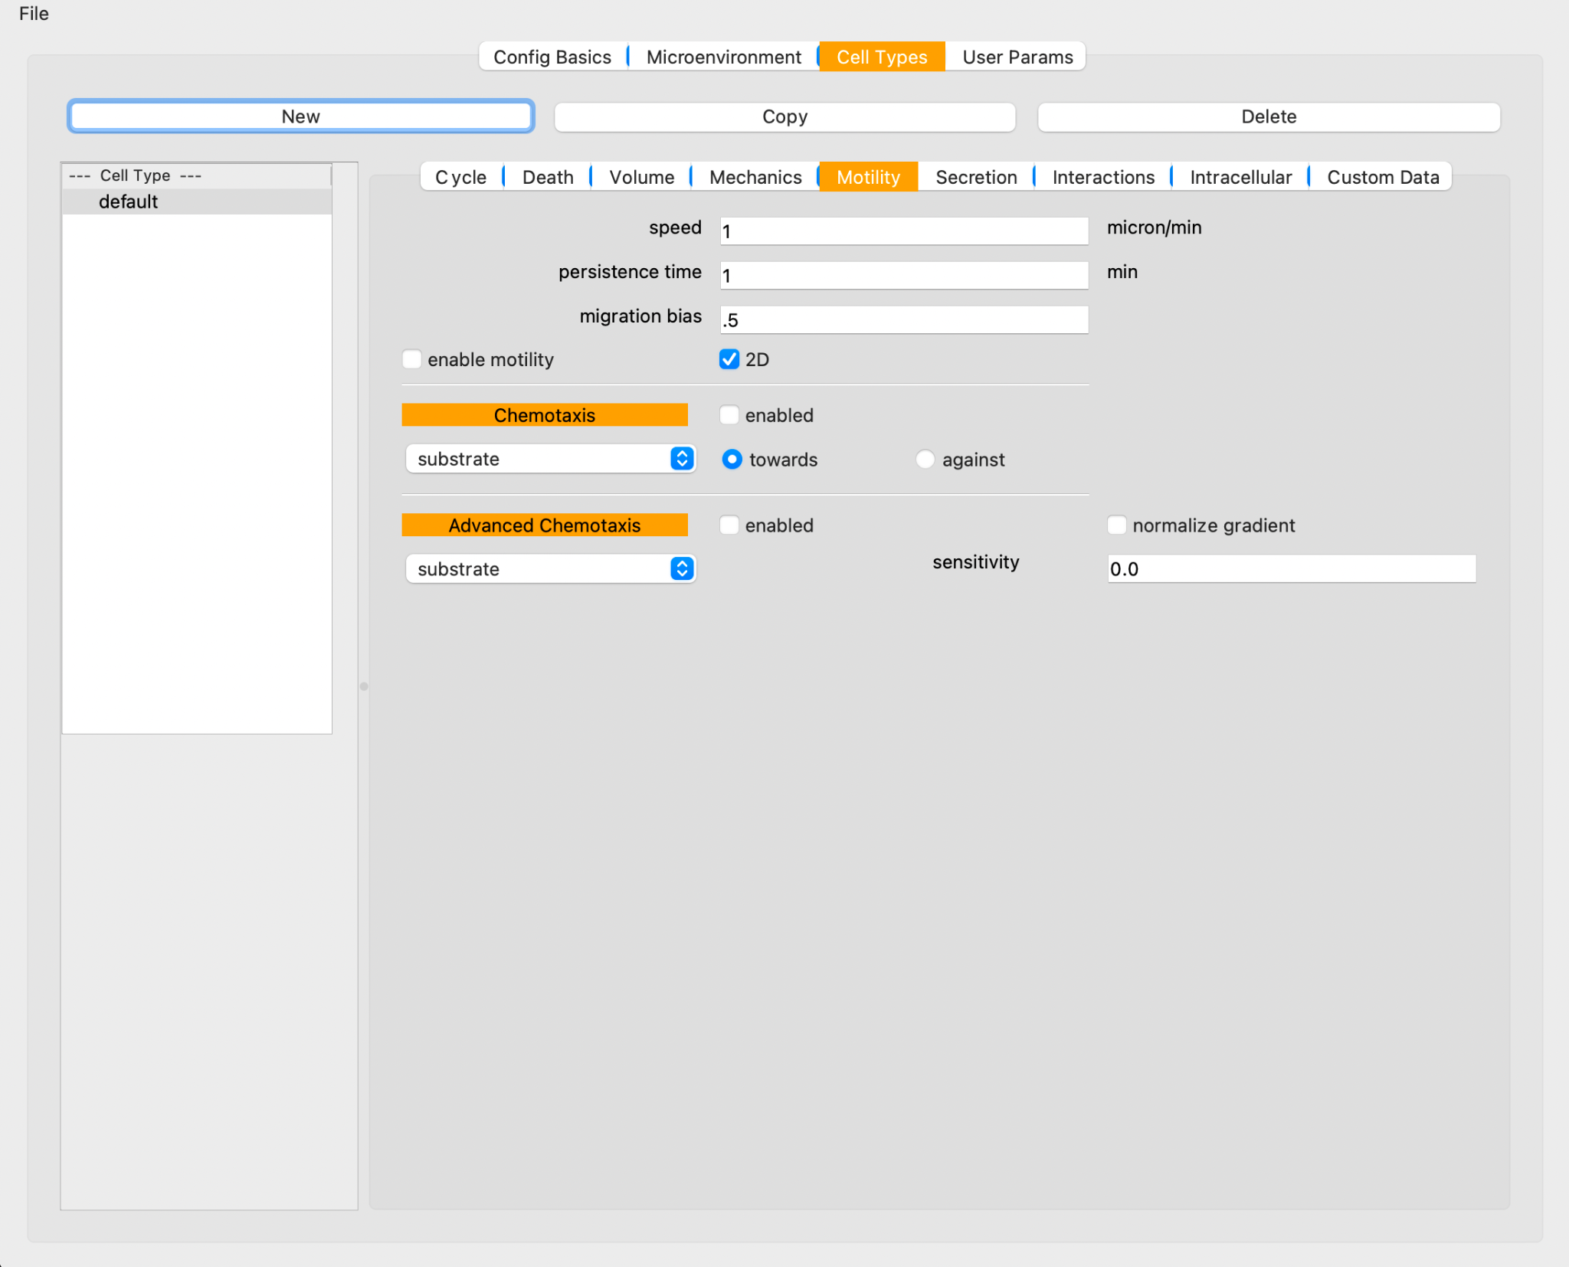
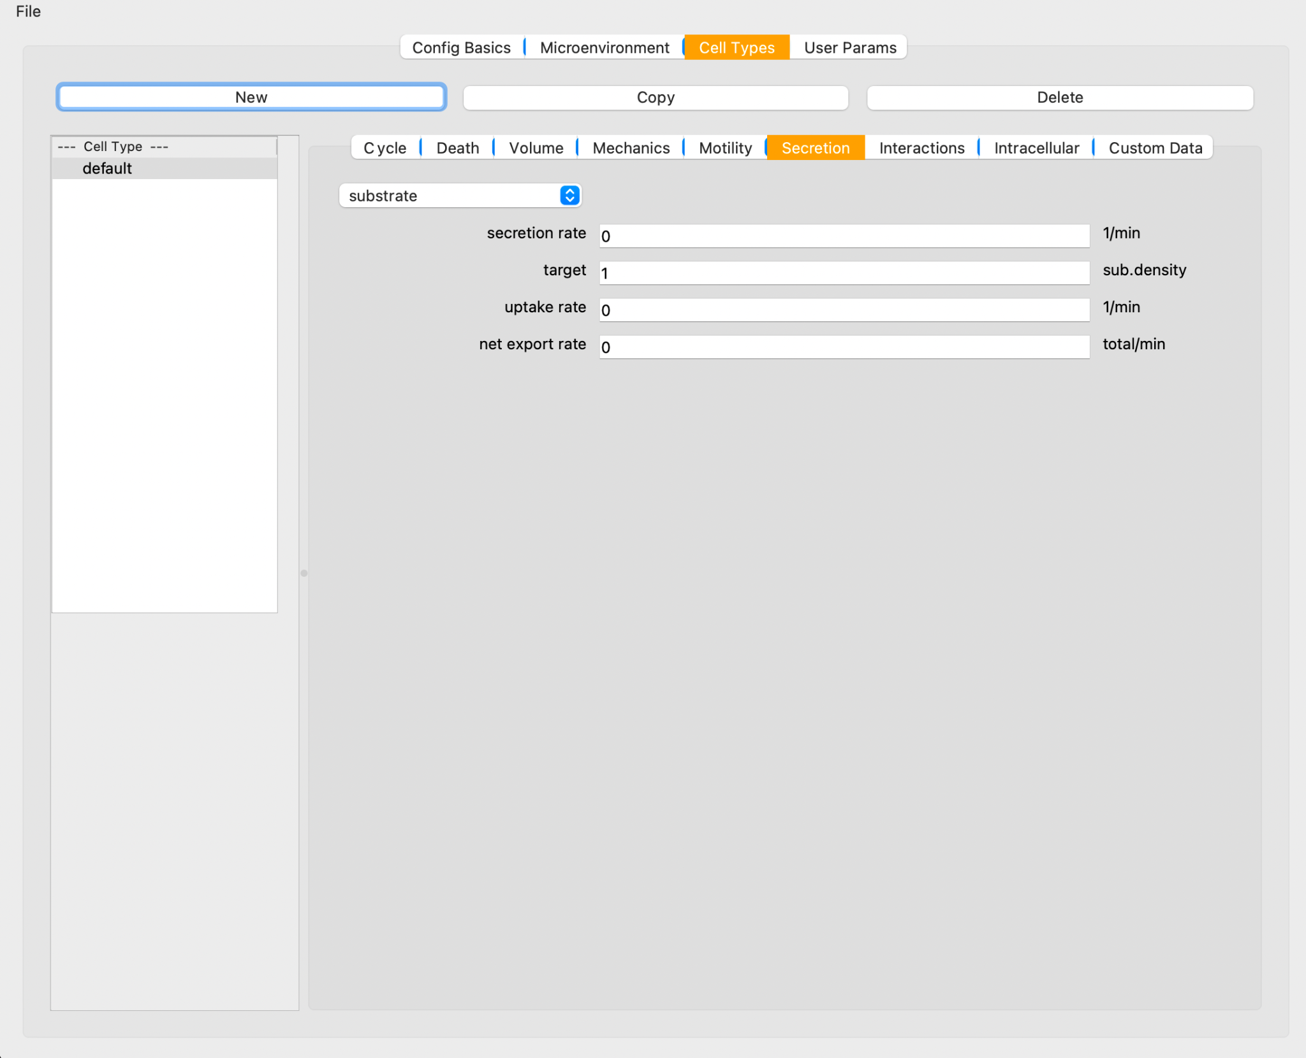
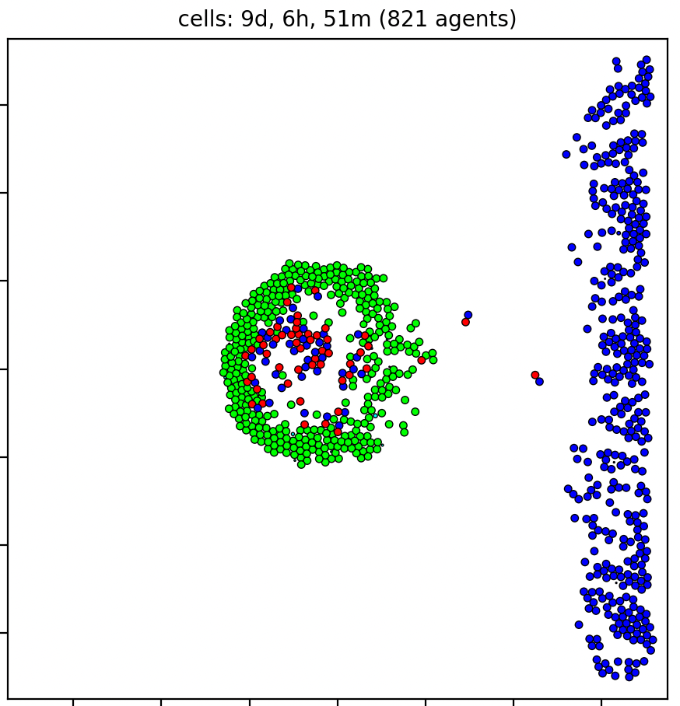
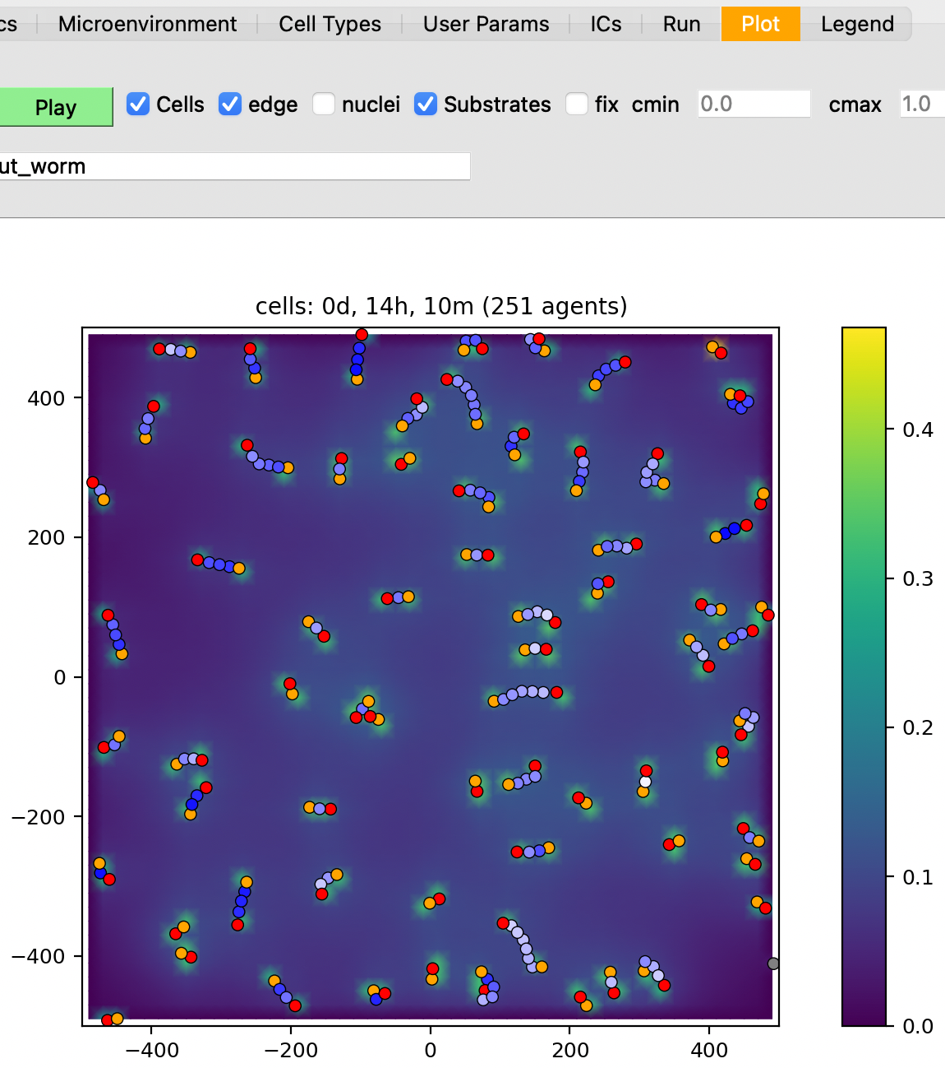
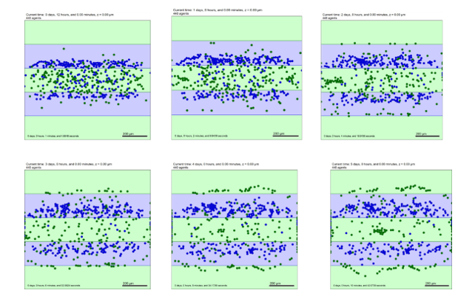




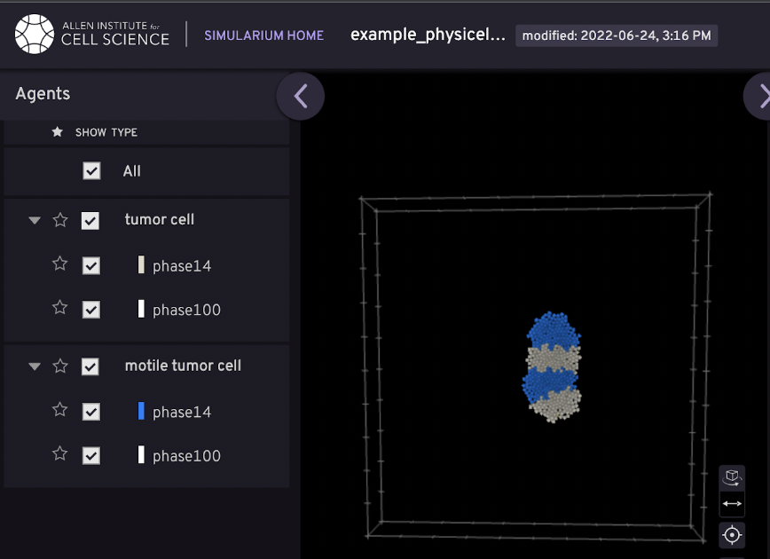
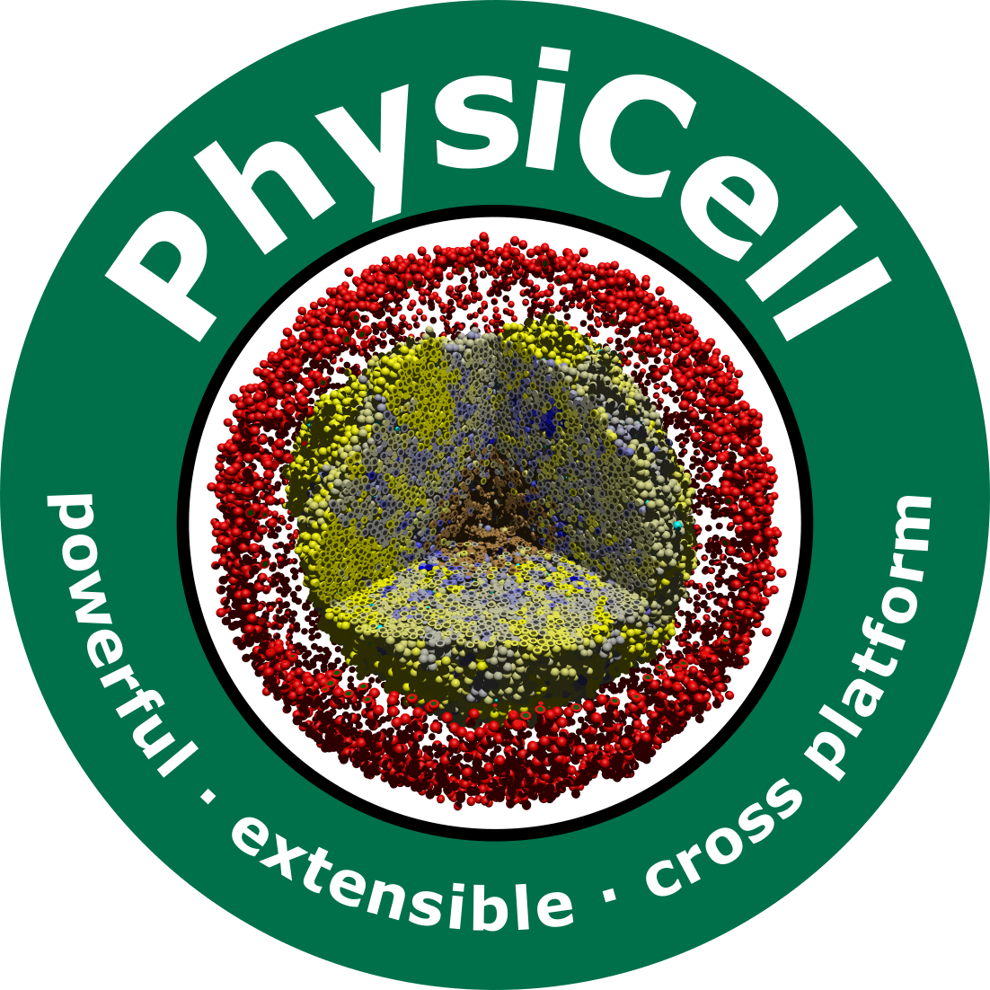
PhysiCell Studio + Cyanobacteria model Nicholas Goh, Carlos Juarez, Grant Maxey, Jay Thilking, Yuchen Yang (Mentors: Randy Heiland, Aneequa Sundus, Drew Willis, Paul Macklin*)
*macklinp@iu.edu
PhysiCell [1] is an open source, agent-based multicellular systems simulation software package. It was originally designed to only be run from the command line.
Depending on its complexity, a PhysiCell model may have 100s of parameters. These are provided in an XML file. Output files consist of both SVG and MultiCellDS [2] formats.
PhysiCell Studio is a graphical user interface (GUI) that offers 1) easy creation/editing of a model and its parameters, 2) initial conditions for cells: types and positions, 3) running a simulation, and 4) visualizing results.
Packaging the Studio and executable models for cross-platform distribution is being tested.
https://github.com/PhysiCell-Tools/PhysiCell-model-builder
Introduction
Results
biorobots
virus-macrophage
https://fury.gl/
cancer-biorobots
worms
PhysiCell Studio is a multi-tabbed GUI to create and edit a model’s parameters, run the model, and visualize results. The GUI helps eliminate errors via constraints and validation.
Plotting results of some PhysiCell sample models
Funding
Breast Cancer Research Foundation
Jayne Koskinas Ted Giovanis Foundation for Health and Policy
National Cancer Institute (U01CA232137)
National Science Foundation (1720625)
Pyinstaller was used to bundle all Python files and libraries into one package for distribution to PhysiCell Studio users. This was especially helpful for distributing the software to Windows users, who could then click on one executable file to run the Studio.
Tools used for the Studio
Python + 3rd-party pkgs, e.g. PyQt5, Matplotlib, VTK.
CMake/CPack for packaging cross-platform executable models.
The Studio will be capable of exporting simulation data to other formats, e.g., Allen Institute’s Simularium, ParaView, plotly.js, etc.
References
[1] Ghaffarizadeh A, Heiland R, Friedman SH, Mumenthaler SM, Macklin P. 2018. “PhysiCell: An open source physics-based cell simulator for 3-D multicellular systems.” PLOS Computational Biology 14(2): e1005991. doi: 10.1371/journal.pcbi.1005991
[2] Friedman, S. H., A. R. A. Anderson, D. M. Bortz, A. G. Fletcher, H. B. Frieboes, et al. 2016. “MultiCellDS: A Standard and a Community for Sharing Multicellular Data.” bioRxiv. doi.org/10.1101/090696
[3] Heiland, R., D. Mishler, T. Zhang, E. Bower, and P. Macklin. 2019. “xml2jupyter: Mapping Parameters between XML and Jupyter Widgets.” Journal of Open Source Software 4 (39). doi.org/10.21105/joss.01408
This simulation demonstrates opto-genetic switches in Cyanobacteria(blue-green algae). Blue and green cells communicate using chemical signals. Blue cells migrate towards blue regions. Green cells avoid blue light and disperse freely.

